Slide 1
AvengerZ
Robocup 2016

Slide 2
Process of development
Brainstorm for the foundation of each module
If it works, put it into a version with release notes
Brainstorm the exceptions
Code the ideas
Test the code
Integrate each module into each other

Slide 3
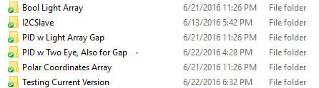
Versioning

Slide 4
Since Last Competition
We decided to add an arduino EV3 hyrid for multiple reasons. Obstacle would not take much time, which was one of the biggest failures last competition, obstacle and time.
The evacuation room would be more precise
We decided to add a light array because the gap would not be a basic state, and we needed more sensors to align securely

Slide 5
Structured Programming
Debug easier
Easier Development (allowed people to develop different parts of the code)
Easier to read, understand, change

Slide 6
Linetracing Module
Foundation: Two-Eye Ad-hoc Line Tracing
Exception: Green
Exception: Intersection
Exception: Gap
Exception: Zigzag

Slide 7
Obstacle Module
Traced the object using the side sensors until one of the left or right sensors see black
Then we turn and then go back onto the line and resume line tracing

Slide 8
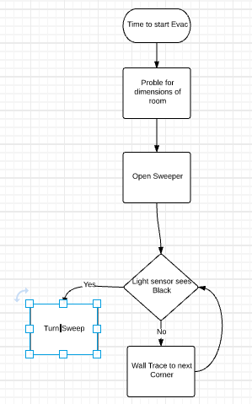
Evacuation Module

Slide 9
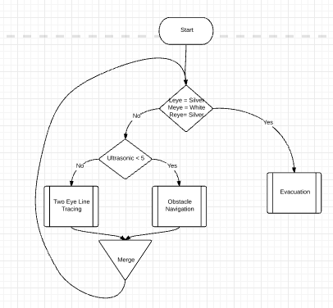
Putting Everything Together

Slide 10
Engineering Journal
Documented what we did that day
Solved and ongoing problems
Solutions to problems
Homework

Slide 11
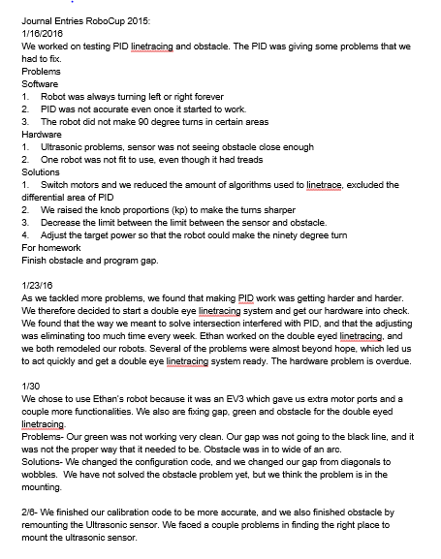
One page of our journal entry

Slide 12
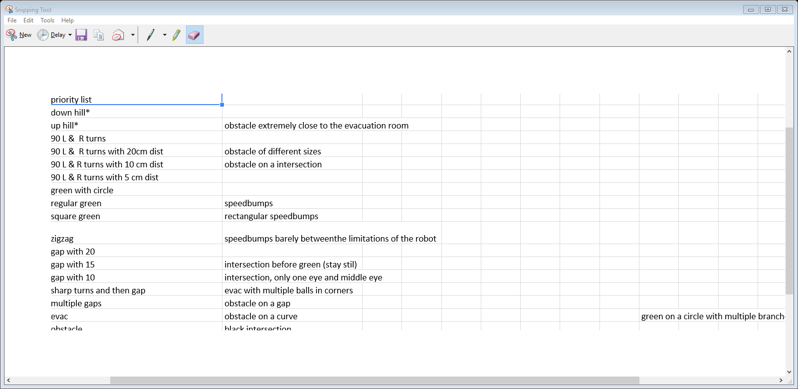
Priority lists/ Project Plan

Slide 13
Communications
Google Drive (Journal, Project Plan)
Emails
Storming Robots
Dropbox (Code)
Skype

Slide 14
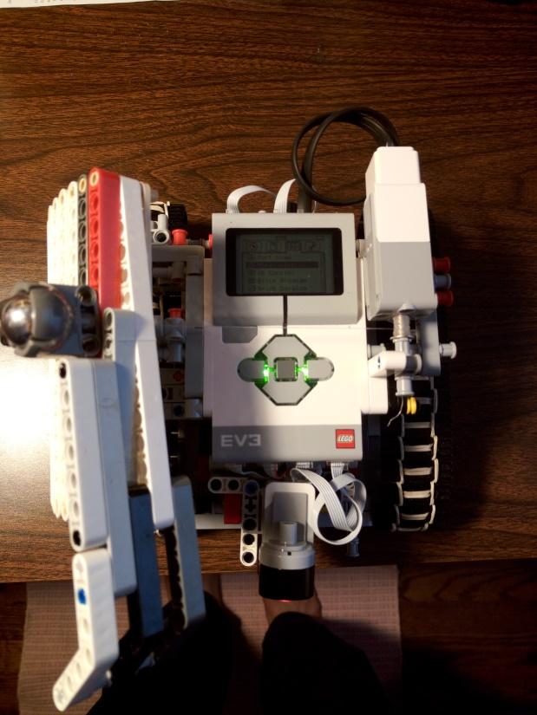
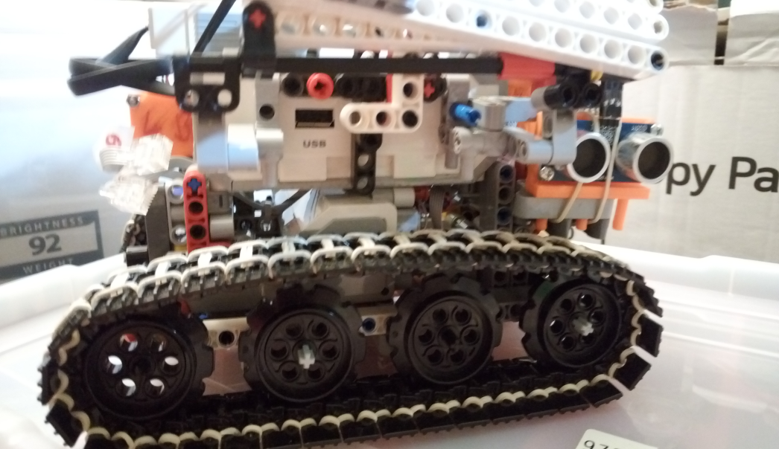
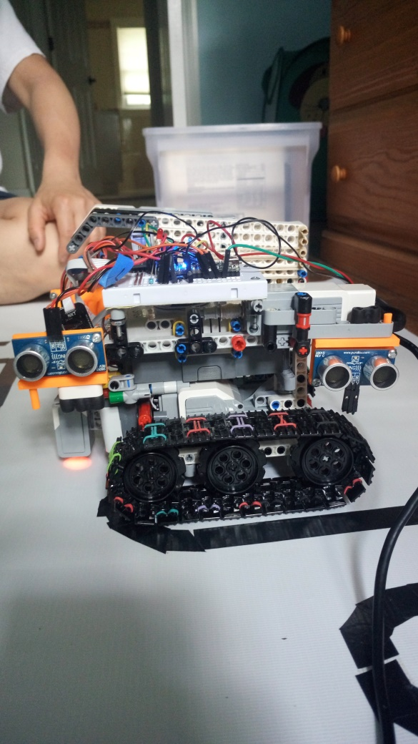
Versions
This is our robot on april 16
This is our robot on May 27
This is our robot may 15

Slide 15
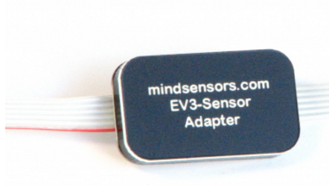
EV3 sensor adapter
Ethan used one sensor adapter, and Shikhar used 4. Shikhar used more sensor adapters because we wanted to have a backup which was not having Arduino, in case it failed.

